Slide 1
Tree
in
Data Structure

Slide 2

Logic of Tree
Used to represent hierarchica data.
Purna(CEO)
Madhav Tarun
Harsh Hardik Vishank Aaksh Nirav
Raj Kunal Kishan Manan

Slide 3
TRee
Nodes
A Collection of entities called Nodes.
Tree is a Non-Linear Data Structure.
It’s a hierarchical Structure.

Slide 4
Relation of TRee
Root-The top most Node.
Children
Parents
Siblings- Have same parents.
Leaf- Has no Child.
1
2
3
4
5
7
6
8
9
10
11

Slide 5
Edges, Depth, Height
Nodes
Edges: If a tree have N nodes
It have N-1 edges.
Depth of x: Length of path from
Root to x.
Hight of tree: Length of longest
Path from root to a leaf
Leaf

Slide 6
Some Application of Tree in Computer Science
Storing naturally hierarchicl data- File system.
Organige data for quick search, insertion, deletion- Binary search tree.
Dictionary
Network Routing Algorithm.

Slide 7
Binary TRee
Root
Each node can have at most 2 childern.
A node have only left and right child or
Only left child or
Only right child.
A leaf node has no left or right child.
A leaf node has only NULL.
Left-child of root
Right- child of root.
Leaf
NULL

Slide 8
1. Strict/Proper binary tree
Root
Each node can have either
2 or 0 child

Slide 9
2. Complete binary tree
Root
Every Level , except last level
is completely filled.
All nodes are as left as possible.
L-1
L-2
L-3
L-4

Slide 10
3. Perfect binary tree
Root
All the levels are comletely filled.
L-1
L-2
L-3

Slide 11
We can implement binary tree using
A) Dynamically created nodes.
struct node
{
int data;
struct node* left;
struct node* right
}
2
4
6

Slide 12
or
0 1 2 3 4 5 6
B) Arrays: It only works “complete Binary tree”.
For node at index i;
Left-child-index=2i+1
Right-child-index=2i+2
2 4 1 5 8 7 9

Slide 13
binary search tree
A binary search tree is a binary tree where all values in left subtree < value in current node < values in right subtree.
This rule must hold for EVERY subtree
Left-Subtree Right-Subtree
(Lesser) (Greater)

Slide 14
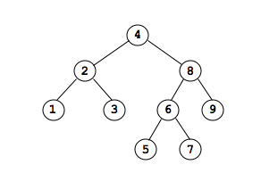
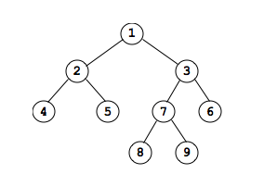
The following is a binary search tree:
The following is NOT binary search tree:

Slide 15
Insertion in binary search trees
To insert into a binary search tree, we must maintain the nodes in sorted order.
Example Insert 15 10 20 8 12 17 25

Slide 16
Example
Root
15
15>10-Left
15<20-Right
10>8-Left
10<12-Right
20>17-Left
20<25-Right
10
20
8
12
17
25
Notes:
15 10 20 8 12 17 25

Slide 17
Removal in binary search trees
In order to delete a node, we must be sure to link up the subtree(s) of the node properly.
Suppose we start with the following binary search tree:

Slide 18
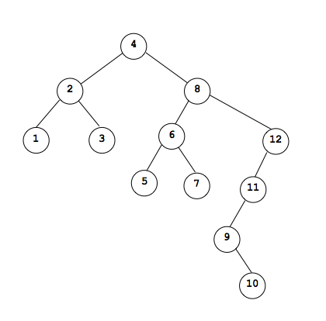

Slide 19
Suppose we want to remove 7 from the tree:-
BEFORE:-

Slide 20
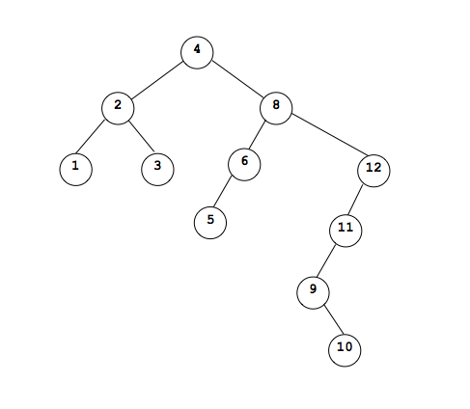
Suppose we want to remove 7 from the tree:-
BEFORE:-
AFTER:-

Slide 21
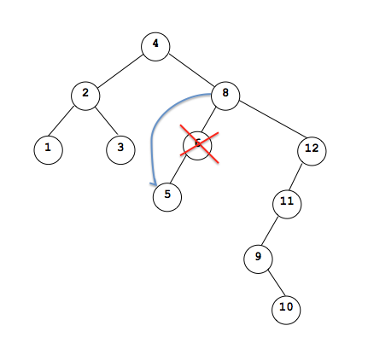
Now, Lets remove the node 6 which has only a left child but no right child.

Slide 22
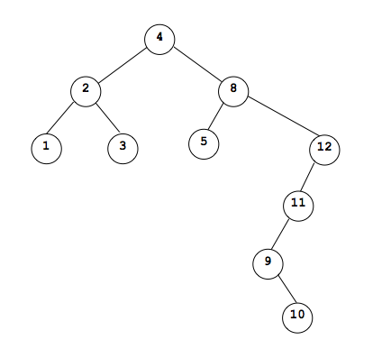
Now, Lets remove the node 6 which has only a left child but no right child.

Slide 23
Now suppose we wanted to remove a node like 8.

Slide 24
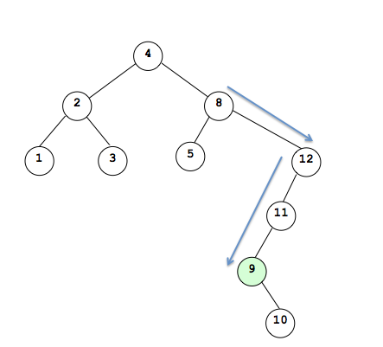
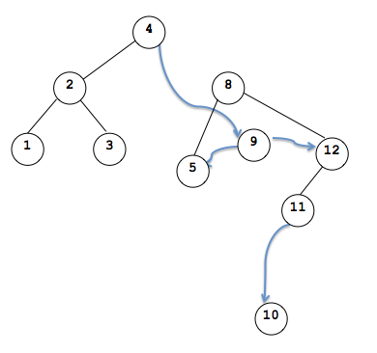

Slide 25
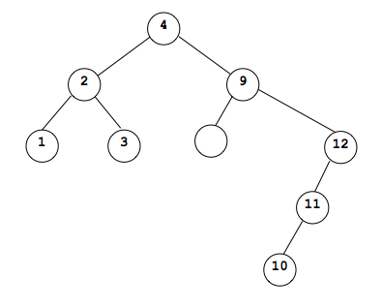
5

Slide 26
Remove / Delete a node from bst
Root
12
There are three Case to delete.
Case 1: No Child
Case 2: One Child
Case 3: Two Child
5
15
3
7
13
17
8
11
14

Slide 27
Case 1: No child
Root
12
Remove to reference of the Node
From it’s parent &
Return NULL
5
15
3
7
13
17
8
11
14

Slide 28
Case 2: One child
Root
12
Find the Node to Delete
Link it’s parent to this only child.
Remain attached to the tree.
5
15
3
7
13
17
8
11
14

Slide 29
Case 3: two child
Root
12
Two way to delete.
1.
Find minimum in right
Copy the value in targetted node
Delete duplicate from right subtree.
5
15
3
7
13
17
8
11
14

Slide 30
Case 3: two child
Root
12
2.
Find maximum in left
Copy the value in targetted node
Delete duplicate from left-subtree.
5
15
3
7
13
17
8
11
14

Slide 31
Binary Tree Traversal
Traversal is the process of visiting every node once
Visiting a node entails doing some processing at that node, but when describing a traversal strategy, we need not concern ourselves with what that processing is

Slide 32
Binary Tree Traversal Techniques
Three recursive techniques for binary tree traversal
In each technique, the left subtree is traversed recursively, the right subtree is traversed recursively, and the root is visited
What distinguishes the techniques from one another is the order of those 3 tasks

Slide 33
Preoder, Inorder, Postorder
In Preorder, the root
is visited before (pre)
the subtrees traversals
In Inorder, the root is
visited in-between left
and right subtree traversal
In Postorder, the root
is visited after (post)
the subtrees traversals
Preorder Traversal:
Visit the root
Traverse left subtree
Traverse right subtree
Inorder Traversal:
Traverse left subtree
Visit the root
Traverse right subtree
Postorder Traversal:
Traverse left subtree
Traverse right subtree
Visit the root

Slide 34
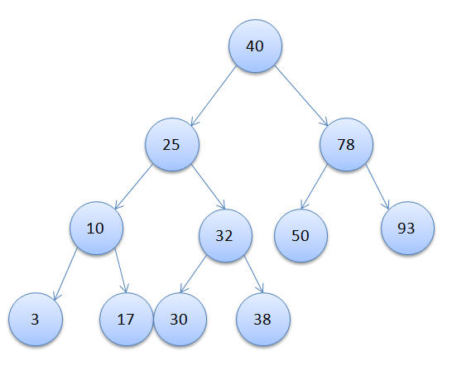
Illustrations for Traversals(Btree)

Slide 35
Illustrations for Traversals
Assume: visiting a node is printing its label
Preorder:
40 25 10 3 17 32 30 38 78 50 93
Inorder:
3 10 17 25 30 32 38 40 50 78 93
Postorder:
3 17 10 30 38 32 25 50 93 78 40

Slide 36
Illustrations for Traversals (BST)
Assume: visiting a node is printing its data
Preorder: ? ? ?
Inorder: ? ? ?
Postorder: ? ? ?
15
8
20
2
11
27
6
10
12
22
30
3
7
14

Slide 37
Illustrations for Traversals (Contd.)
Assume: visiting a node is printing its data
Preorder:
15 8 2 6 3 7 11 10 12 14 20 27 22 30
Inorder:
2 3 6 7 8 10 11 12 14 15 20 22 27 30
Postorder:
3 7 6 2 10 14 12 11 8 22 30 27 20 15
15
8
20
2
11
27
6
10
12
22
30
3
7
14

Slide 38
Example: For Given Inorder and Preorder
Inorder sequence: D B E A F C
Preorder sequence: A B D E C F

Slide 39
Example: For Given Inorder and Preorder
Inorder sequence: D B E A F C
Preorder sequence: A B D E C F
Root Node :- A
Left SubTree :- D B E
Right SubTree :- F C

Slide 40
Example: For Given Inorder and Preorder
Inorder sequence: D B E A F C
Preorder sequence: A B D E C F
Root Node :- A
Left SubTree :- D B E
Right SubTree :- F C
A
B
C
D
E
F

Slide 41
Example: For Given Inorder and Preorder
Inorder: D B H E A I F J C G
Preorder: A B D E H C F I J G
Now root is A
Left subtree: D B H E
Right subtree: I F J C G

Slide 42
Example: For Given Inorder and Preorder
Inorder: D B H E A I F J C G
Preorder: A B D E H C F I J G
Now root is A
Left subtree: D B H E
Right subtree: I F J C G
A
B
C
D
E
G
F
H
I
J

Slide 43
Example: For Given Inorder and POSTorder
Inorder: 20, 30, 35, 40, 45, 50, 55, 60, 70
Postorder: 20, 35, 30, 45, 40, 55, 70, 60, 50
Now root is :
Left subtree:
Right subtree:

Slide 44
Example: For Given Inorder and POSTorder
Inorder: 20, 30, 35, 40, 45, 50, 55, 60, 70
Postorder : 20, 35, 30, 45, 40, 55, 70, 60, 50
Now root is : 50
Left subtree: 20, 30, 35, 40, 45
Right subtree: 55, 60, 70

Slide 45
Inorder: 20, 30, 35, 40, 45, 50, 55, 60, 70
Preorder: 20, 35, 30, 45, 40, 55, 70, 60, 50
Now root is : 50
Left subtree: 20, 30, 35, 40, 45
Right subtree: 55, 60, 70
Left SubTree :- Root Node :-
Left SubTree :- Root Node:-
Right SubTree :- Left SubTree :-
Right SubTree :-

Slide 46
Inorder: 20, 30, 35, 40, 45, 50, 55, 60, 70
Preorder: 20, 35, 30, 45, 40, 55, 70, 60, 50
Now root is : 50
Left subtree: 20, 30, 35, 40, 45
Right subtree: 55, 60, 70
Left SubTree :- Root Node :- 40
Left SubTree :- 20, 30, 35 Root Node:- 30
Right SubTree :- 45 Left SubTree :- 20
Right SubTree :- 35

Slide 47
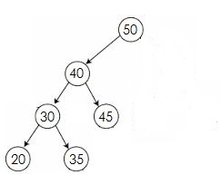
Inorder: 20, 30, 35, 40, 45, 50, 55, 60, 70
Preorder: 20, 35, 30, 45, 40, 55, 70, 60, 50
Now root is : 50
Left subtree: 20, 30, 35, 40, 45
Right subtree: 55, 60, 70
Left SubTree :- Root Node :- 40
Left SubTree :- 20, 30, 35 Root Node:- 30
Right SubTree :- 45 Left SubTree :- 20
Right SubTree :- 35

Slide 48
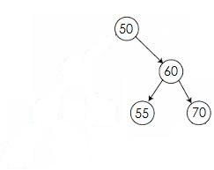
Inorder: 20, 30, 35, 40, 45, 50, 55, 60, 70
Preorder: 20, 35, 30, 45, 40, 55, 70, 60, 50
Now root is : 50
Left subtree: 20, 30, 35, 40, 45
Right subtree: 55, 60, 70
Right SubTree :- Root Node :- 60
Left SubTree :- 55
Right SubTree :- 70

Slide 49
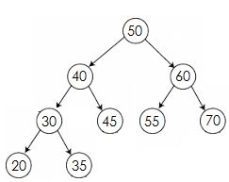
Inorder: 20, 30, 35, 40, 45, 50, 55, 60, 70
Preorder: 20, 35, 30, 45, 40, 55, 70, 60, 50

Slide 50
GTU Questions

Slide 51
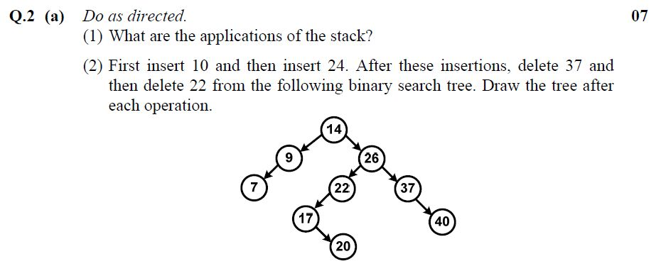

Slide 52
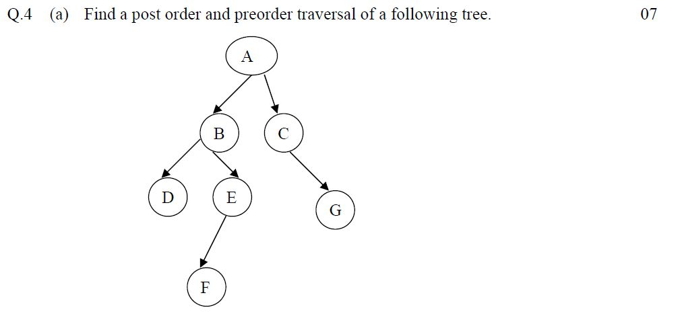

Slide 53
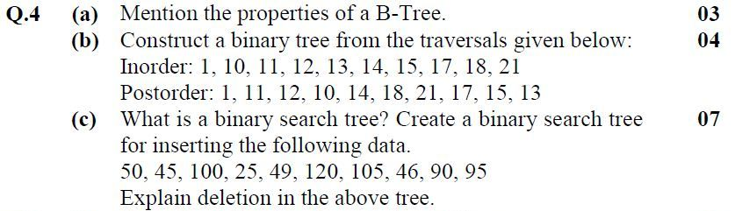
Notes:
InOrder :- 1, 10, 11, 12, 13, 14, 15, 17, 18, 21
PostOrder:- 1, 11, 12, 10, 14, 18, 21, 17, 15, 13

Slide 54
InOrder :- 1, 10, 11, 12, 13, 14, 15, 17, 18, 21
PostOrder:- 1, 11, 12, 10, 14, 18, 21, 17, 15, 13
Now root is : 13
Left subtree: 1, 10, 11, 12
Right subtree: 14, 15, 17, 18, 21
Left SubTree :- Root Node :- 10
Left SubTree :- 1
Right SubTree :- 11, 12 Root Node :- 12
Left SubTree :- 11

Slide 55
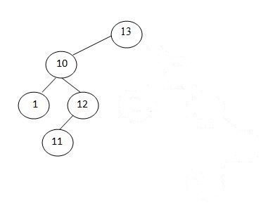
InOrder :- 1, 10, 11, 12, 13, 14, 15, 17, 18, 21
PostOrder:- 1, 11, 12, 10, 14, 18, 21, 17, 15, 13
Now root is : 13
Left subtree: 1, 10, 11, 12
Right subtree: 14, 15, 17, 18, 21
Left SubTree :- Root Node :- 10
Left SubTree :- 1
Right SubTree :- 11, 12 Root Node :- 12
Left SubTree :- 11

Slide 56
InOrder :- 1, 10, 11, 12, 13, 14, 15, 17, 18, 21
PostOrder:- 1, 11, 12, 10, 14, 18, 21, 17, 15, 13
Now root is : 13
Left subtree: 1, 10, 11, 12
Right subtree: 14, 15, 17, 18, 21
Left SubTree :- Root Node :- 15
Left SubTree :- 14
Right SubTree :- 17, 18, 21 Root Node :- 17
Right SubTree :- 18, 21 Root:- 21
Left:- 18

Slide 57
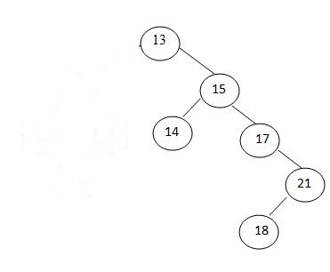
InOrder :- 1, 10, 11, 12, 13, 14, 15, 17, 18, 21
PostOrder:- 1, 11, 12, 10, 14, 18, 21, 17, 15, 13
Now root is : 13
Left subtree: 1, 10, 11, 12
Right subtree: 14, 15, 17, 18, 21
Left SubTree :- Root Node :- 15
Left SubTree :- 14
Right SubTree :- 17, 18, 21 Root Node :- 17
Right SubTree :- 18, 21 Root:- 21
Left:- 18

Slide 58
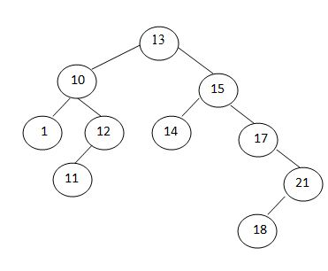
InOrder :- 1, 10, 11, 12, 13, 14, 15, 17, 18, 21
PostOrder:- 1, 11, 12, 10, 14, 18, 21, 17, 15, 13

Slide 59
Notes:
InOrder :- 1, 10, 11, 12, 13, 14, 15, 17, 18, 21
PostOrder:- 1, 11, 12, 10, 14, 18, 21, 17, 15, 13

Slide 60
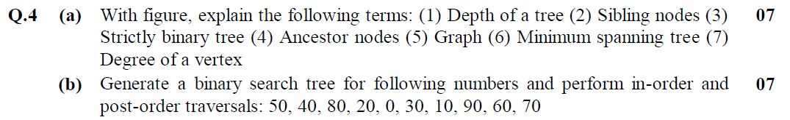

Slide 61
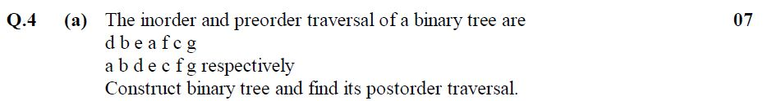

Slide 62
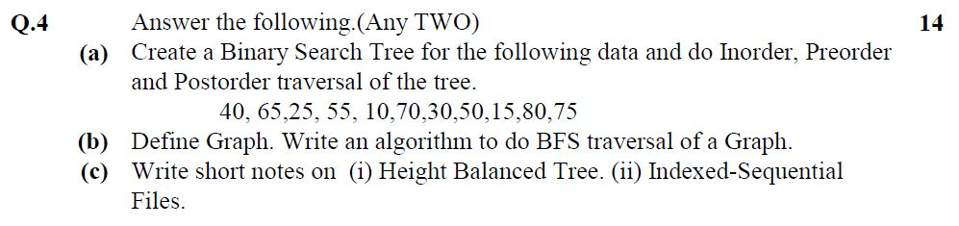

Slide 63
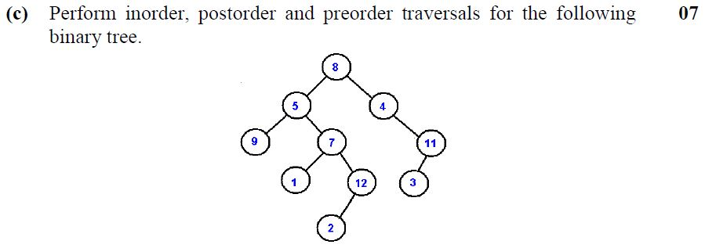

Slide 64
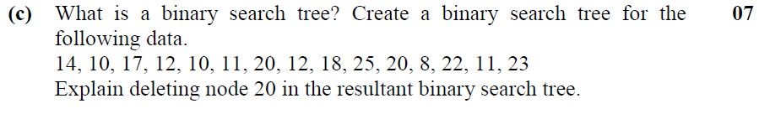

Slide 65
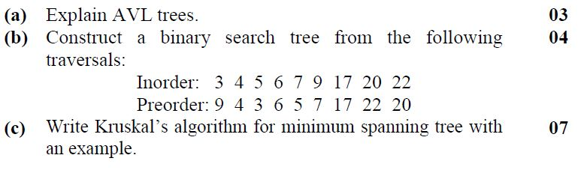

Slide 66
BINARY TREE ALGORITHM

